Slide 1

Introduction to Artificial Intelligence in Education
Interactive Lesson for K-12 Teachers
Presented by: Kaylee Stemmer
Notes:
Welcome to this interactive lesson on Artificial Intelligence in Education. During this lesson, you will learn what AI is, how it can support teaching and learning, and how educators can use AI responsibly in the classroom.

Slide 2
Introduction

Slide 3

Welcome
Welcome to your interactive learning experience.
Let's explore AI together.
Notes:
Welcome! This interactive lesson introduces artificial intelligence in education. Throughout this lesson, you will complete activities, answer questions, and discover how AI can support teachers while improving student learning.

Slide 4


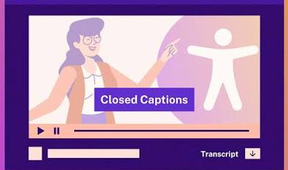
Navigation
Learn how to move through this lesson.
Complete each activity before continuing.
Closed captions are available
Use Next and Previous to move between slides
Complete each activity before moving on
Notes:
Use the Next and Previous buttons to move through the lesson. Closed captions are available throughout the presentation. Complete each activity before advancing to the next section.

Slide 5


Purpose
AI can support teachers and students.
Responsible use improves learning.
Notes:
Artificial Intelligence is becoming a valuable educational tool. This lesson will help you understand how AI can improve teaching while emphasizing reponsible and ethical classroom use.

Slide 6

Expectations
Complete every activity independently.
Finish the lesson and final assessment.
✅ Complete every activity
✅ Participate honestly
✅ Finish the lesson
Notes:
Please complete each activity independently and answer each question thoughtfully. At the end of the lesson, you will complete a short assessment to demonstrate what you have learned.

Slide 7

Technology
A computer and internet connection are required.
Speakers or headphones are recommended.
Required:
Computer
Internet
Audio
Notes:
To complete this lesson successfully, you will need a computer, reliable internet access, and speakers or headphones for the narrated content.

Slide 8

Meet Alex
Alex will guide you through this lesson.
Let’s learn together.
Meet Alex
Your AI Learning Guide
Notes:
Hello! My name is Alex, and I'll be your guide throughout this lesson. I'll introduce each topic, ask questions, and help you understand how AI can be used responsibly in education.

Slide 9

Experience
Question: How familiar are you with AI in education?
Directions
Turn the dial to choose your experience level.
1- Never Used AI
2- Heard of AI
3- Used AI Sometimes
4- Comfortable
5- Very Experienced
Character State Changes
1 😟 Concerned
2 😐 Neutral
3 🙂 Smiling
4 😄 Happy
5 🤩 Excited
Notes:
Turn the dial to show your current experience with artificial intelligence in education. There are no right or wrong answers.

Slide 10

Reflection
Everyone begins somewhere.
This lesson is for every experience level.
Notes:
Whether you've never used AI or already have experience, this lesson is designed to help you learn practical ways to use AI responsibly in your classroom.

Slide 11
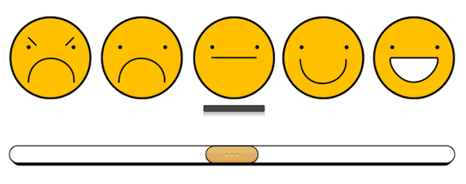
Confidence
Question: How confident are you using AI in your classroom?
Directions
Move the slider to the number that best describes your confidence.
1 2 3 4 5
1 Not Confident
2 Slightly Confident
3 Somewhat Confident
4 Confident
5 Very Confident
Notes:
Move the slider to indicate how confident you feel about using AI in education. You'll revisit this question at the end of the lesson.

Slide 12


Ready
Learning builds confidence.
Let's begin exploring AI.
Notes:
As you move through this lesson, think about how your confidence grows while learning more about artificial intelligence.

Slide 13
Triggering Phase
T
Notes:
Whether you've never used AI or already have experience, this lesson is designed to help you learn practical ways to use AI responsibly in your classroom.

Slide 14


Why AI?
Artificial intelligence is changing education.
Teachers need to understand how to use it responsibly.
Notes:
Artificial intelligence is becoming more common in schools. Teachers use AI to create lesson plans, personalize instruction, and save time. Understanding AI helps educators make informed decisions.

Slide 15


Big Idea
AI supports teaching.
Teachers remain at the center of learning.
Notes:
The big idea of this lesson is that artificial intelligence can improve teaching and learning when used responsibly. Technology supports teachers, but educators remain the most important part of every classroom.

Slide 16
Your Thoughts
Question
Which statement best describes your opinion about AI?
Choose one answer.
I'm excited to use AI.
I'm curious but unsure.
I'm nervous about AI.
I know very little about AI.

Slide 17

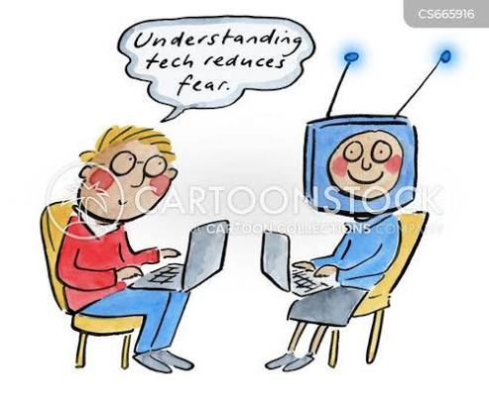
Great Start
Everyone has different experiences.
This lesson will build your understanding.
Notes:
Thank you for sharing your opinion. Throughout this lesson, you'll explore reliable information that will help you better understand artificial intelligence in education.

Slide 18


Definition
Artificial intelligence performs tasks that normally require human thinking.
It is designed to support teachers.
Notes:
Artificial Intelligence refers to computer systems that can generate text, recognize patterns, analyze information, and make recommendations. In education, AI helps teachers save time and support learning.

Slide 19
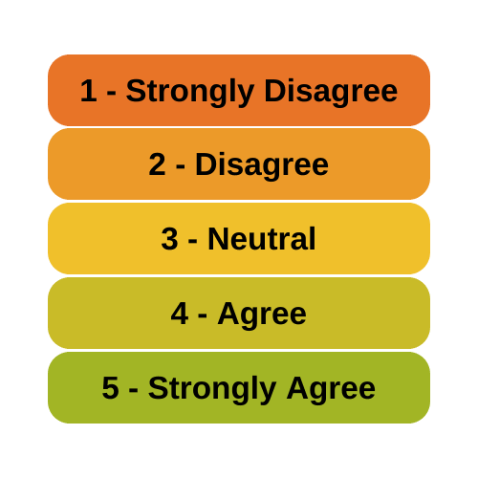
Opinion
Question: AI can be valuable tool for teachers.
Choose one answer
Strongly Disagree
Disagree
Neutral
Agree
Strongly Agree
Notes:
Whether you've never used AI or already have experience, this lesson is designed to help you learn practical ways to use AI responsibly in your classroom.

Slide 20

Keep Learning
There are many opinions about AI.
Learning helps us make informed decisions.
Notes:
Throughout this lesson, you'll learn about the benefits and limitations of AI so you can make informed decisions about its use in your classroom.

Slide 21
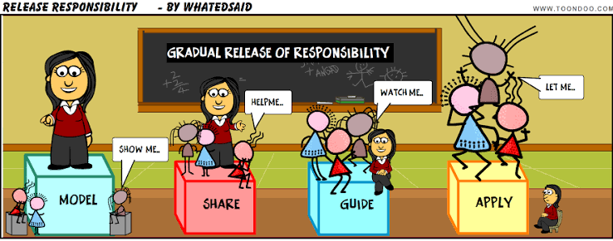
Benefits
AI saves time.
Teachers remain responsible for learning.
Notes:
AI can help teachers create lesson ideas, generate quizzes, summarize information, and personalize instruction. However, teachers should always review AI-generated content before using it with students

Slide 22
Reflection
Question:
What is one way AI could help you in your classroom?
Answer in text box:
Notes:
Throughout this lesson, you'll learn about the benefits and limitations of AI so you can make informed decisions about its use in your classroom.

Slide 23

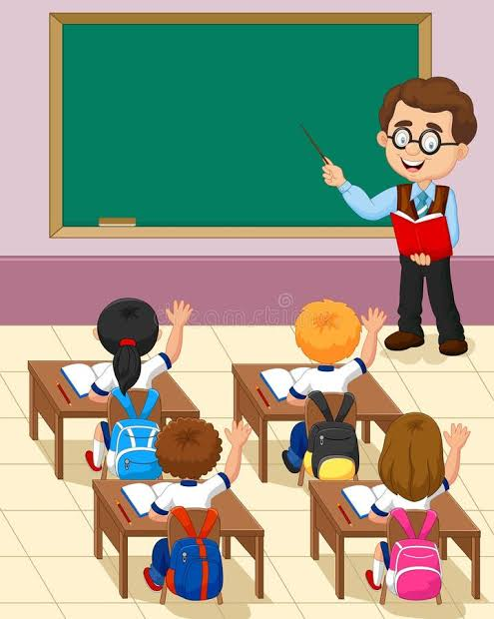
Looking Ahead
Your ideas matter.
Next, you'll explore real classroom examples.
Notes:
Thank you for reflecting on your ideas. In the next phase of this lesson, you'll examine real examples of how teachers use AI responsibly to support student learning.

Slide 24
Exploration Phase
T
Notes:
Whether you've never used AI or already have experience, this lesson is designed to help you learn practical ways to use AI responsibly in your classroom.

Slide 25
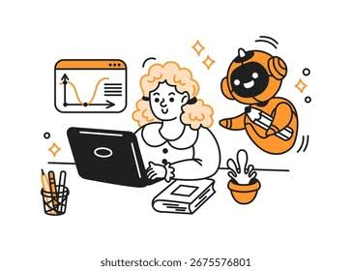
AI Basics
Artificial Intelligence uses technology to complete tasks.
AI can support teaching and learning.
Notes:
During this section, we will explore how artificial intelligence works and how it can be used in educational settings. AI tools can support teachers by assisting with planning, organization and personalized learning.

Slide 26

AI Tools
Teachers can use AI tools for classroom support.
AI helps save time while improving instruction.
Notes:
AI tools can help educators create lesson ideas, organize information, generate examples, and support classroom activities. Teachers should use AI as an assistant while continuing to make professional decisions.

Slide 27
AI Sorting
Drag each time into the correct category.
Move each example into either "AI Support" or "Teacher Responsibility."
Drag Items:
AI Support
Teacher Responsibility
Lesson idea generation
Lesson idea generation
Student relationships
Student relationships
Creating practice activities
Checking accuracy
Checking accuracy
Creating practice activities
Notes:
Interaction
Freeform Drag-and Drap

Slide 28

Balance
AI assists teachers.
Teachers guide meaningful learning.
Notes:
Great job! AI can help educator's complete tasks more efficiently, but teachers remain responsible for relationships, decision-making, and ensuring students receive quality instruction.

Slide 29

Benefits
AI creates opportunities for personalized learning.
Teachers can adjust instruction based on student needs.
Notes:
AI can help teachers personalize instruction by providing resources, generating practice opportunities, and helping organize learning materials. When used appropriately, AI can support different student learning needs.

Slide 30

Examples
AI has many classroom applications.
Responsible use improves learning experiences.
Notes:
Examples of AI use include generating lesson ideas, creating review questions, summarizing information, and brainstorming activities. Teachers should always review AI-created materials before sharing them with students.

Slide 31
Choose
Which teacher is using AI responsibly?
Teacher uses AI answers without checking them.
Teacher lets AI replace instruction.
Teacher reviews and edits AI materials before using them. ✅
Teacher puts private student information into AI.
Directions: Select the best example.
Notes:
Interaction Type
Freeform Pick One

Slide 32

Responsible Use
AI requires thoughtful decisions.
Teachers ensure accuracy and safety.
Notes:
The best choice is reviewing and editing AI materials before classroom use. Responsible AI use requires teachers to check information, protect students, and make professional decisions.

Slide 33

Challenges
AI provides support but also has limitations.
Educators must be critical thinking.
Notes:
Although AI has many benefits, it can make mistakes or provide inaccurate information. Educators must evaluate AI responses carefully before using them in learning environments.

Slide 34

Ethics
Responsible AI use protects students.
Teachers should consider privacy and accuracy.
Notes:
Ethical AI use includes protecting student information, reviewing generated content, and understanding the limitations of technology. Responsible decisions help create safe learning experiences.

Slide 35
Reflection
Question: How could you responsibly use AI in your classroom?
Answer in text box:
Notes:
Interaction Type
Text Entry

Slide 36
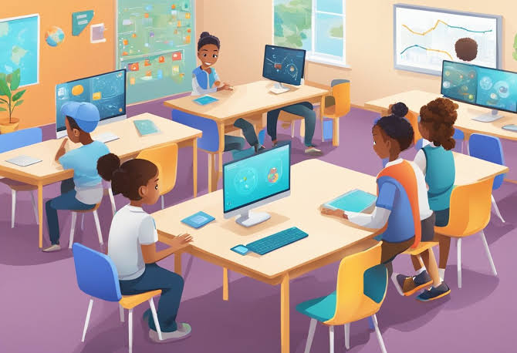
Apply
AI works best with thoughtful educators.
Your decisions shape classroom technology use.
Notes:
Thank you for reflecting on your own classroom. AI is most effective when teachers combine technology tools with their professional knowledge and understanding of students.

Slide 37
Integration Phase
T

Slide 38

Scenario
Mrs. Lopez wants to use AI for lesson planning.
She must make responsible decisions.
Notes:
Meet Mrs. Lopez, a teacher who wants to use AI to create a science lesson. As she explores AI tools, she must decide how to use technology responsibly while supporting her students.

Slide 39

Meet the Characters
Each character provides a different perspective.
Their choices affect AI use.
Mrs. Lopez
Classroom Teacher
Principal Davis
Technology Leader
Alex
AI Learning Coach
Notes:
Throughout this scenario, Mrs. Lopez, Alex, and Principal Davis will discuss different choices related to artificial intelligence. Their decisions will demonstrate responsible AI practices.

Slide 40
Decision
AI created a lesson quickly.
Mrs. Lopez notices possible mistakes.
"AI helped me create this lesson, but some information may not be correct."
"What should you do before sharing it with students?"
Notes:
Mrs. Lopez discovers that AI can save time, but she also realizes teachers must carefully review AI-generated information before using it.

Slide 41
Choices
Principal Davis
Reveal:
"AI works best when teachers review and adjust the information with their students."
Click each character to explore advice.
Each perspective helps Mrs. Lopez decide.
Directions: Click each character to reveal their recommendation.
Mrs. Lopez (Teacher)
Reveal:
"AI helped me create my lesson faster, but I need to make sure the information is accurate".
Alex (AI Coach)
Reveal:
"AI works best when teachers view and adjust the information for their students."
Notes:
Select each character to learn about different perspectives on responsible AI use. Each character provides information that can help Mrs. Lopez make an informed decision.

Slide 42
Choose
Mrs. Lopez must choose her next step.
What is the most responsible choice?
What should Mrs. Lopez do with the AI-created lesson?
Use it immediately without changes
Delete it and never use AI again
Review, edit, and adjust it before teaching ✅
Allow students to correct the mistakes
Notes:
Interaction
Triggers + Layers + State Changes
Character States:
Correct → Happy
Incorrect → Concerned
Mrs. Lopez must decide how to use AI responsibly. Choose the action that best supports students while using technology appropriately.

Slide 43

Review
Responsible teachers evaluate AI content.
Human Decisions guide learning.
Notes:
The best choice is to review and edit AI-generated materials before using them. AI can provide support, but teachers are responsible for ensuring lessons are accurate and meaningful.

Slide 44
Sort
Place each action into the correct category.
Move each example into either "AI Support" or "Teacher Responsibility."
Drag Items:
AI Support
Teacher Responsibility
Generate lesson ideas
Generate lesson ideas
Check accuracy
Create practice questions
Create practice questions
Build relationships
Check accuracy
Build relationships
Notes:
Interaction
Freeform Drag-and Drap

Slide 45
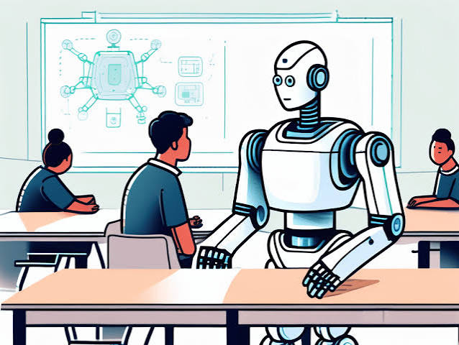
Balance
AI and teachers work together.
Each has an important role.
Notes:
AI can support classroom tasks, but teachers bring professional knowledge, creativity, and relationships that technology cannot replace.

Slide 46
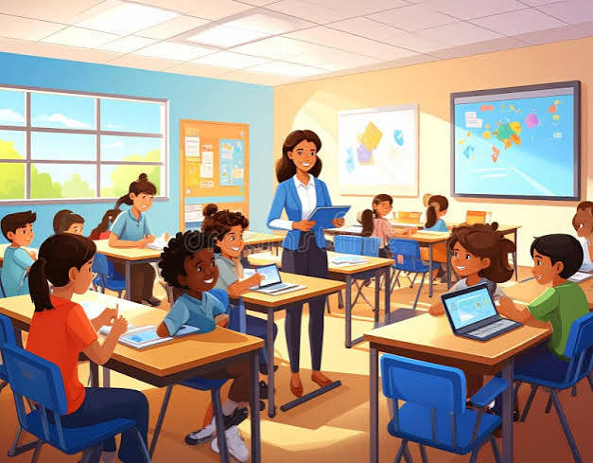
Apply
AI can become part of responsible teaching.
Educators make the final decisions.
Notes:
Throughout this case study, you practiced making decisions about AI use. Responsible educators combine technology with professional judgment to create meaningful learning experiences.

Slide 47
Resolution Phase
T

Slide 48
Certificate
Directions:
Enter your name before beginning the final quiz
Answer in text box:
Name: ______________________________
Notes:
Please enter your name before starting the final assessment. Your name will appear on your quiz results page after completing the lesson.

Slide 49
Final Quiz
Show what you learned about AI.
Complete the final assessment.
5 Questions​
​
Passing Score: 80%
Notes:
You will now complete the final assessment. Answer each question based on what you learned throughout this interactive lesson. You need an 80 percent score to successfully complete the quiz.

Slide 50
Question 1 (True/False)
Question:
AI is designed to completely replace classroom teachers.
True
False ✅
Notes:
Feedback
Correct! AI supports educators but does not replace teachers.

Slide 51
Question 2 (Multiple Choice)
Question:
Which example shows responsible AI use?
Copying everything AI use?
Sharing student information
Reviewing AI materials before teaching ✅
Ignoring AI mistakes
Notes:
Feedback
Teachers should always review AI-generated information.

Slide 52
Question 3 (Multiple Choice)
Question:
Select ways AI can support educators.
Select all correct answers.
☑ Creating lesson ideas ☑ Generating practice questions ☑ Organizing information ☐ Replacing teachers
Notes:
Feedback
AI supports classroom tasks but teachers remain responsible for instruction.

Slide 53
Question 4 (Fill-in-the-Blank)
Question:
Teachers should always ______________ AI-generated information before using it.
Correct Answer:
Review
Notes:
Feedback
Reviewing AI content helps ensure accuracy and responsible use.

Slide 54
Question 5 (Matching)
Question:
Match the responsibility
AI → Generates ideas
Teacher → Makes instructional decisions
AI → Organizes information
Teacher → Supports student relationships

Slide 55
Results
Results for: %Name%
Your Score:_____
Passing Score: 80%
Buttons:
Print Results
Save PDF
Retry Quiz

Slide 56

Congratulation
AI can support effective teaching.
Responsible educators guide learning.
Notes:
Congratulations on completing this interactive lesson. You explored artificial intelligence, practiced responsible decision-making, and learned how AI can support education. Remember, technology is a tool, but teachers create meaningful learning experiences.

Slide 57
Resources
Continue learning about AI.
Explore responsible technology practices.
AI for Teachers Open Educational Resource
URL: https://edtechbooks.org/
OER Commons Artificial Intelligence Collection
URL: https://oercommons.org/
AI and Education Materials from EdTech Books
URL: https://edtechbooks.org/
Notes:
Continue exploring reliable resources to learn more about artificial intelligence in education and how it can support teaching practices.

